Slide 1
Chapter 8 – Cell-Material Interactions

Slide 2
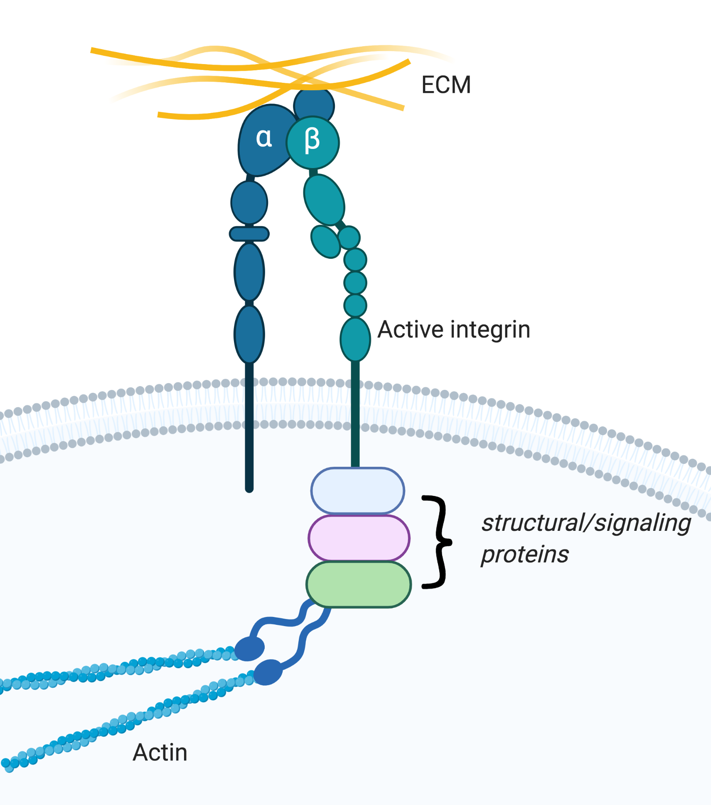
Notes:
Figure 8.1: The integrin adhesion complex (IAC) at the plasma membrane, creating a direct link from ECM to intracellular components.
Created with BioRender.com.

Slide 3
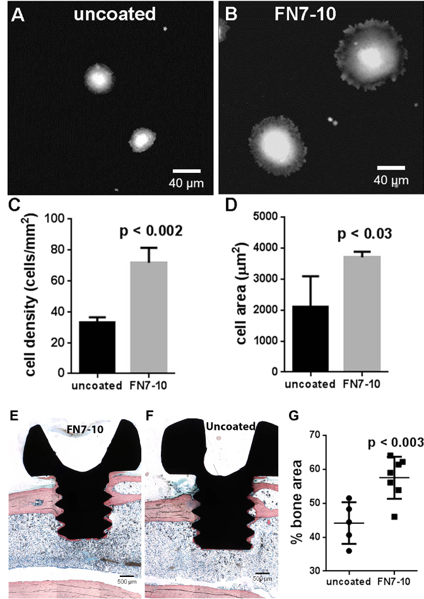
Notes:
Figure 8.2: Fibronectin fragment (FN7-10) coating of stainless-steel screws enhances cell adhesion (A-D) and osteogenic implant integration (E-G).
From Simple Coating with Fibronectin Fragment Enhances Stainless Steel Screw Osseointegration in Healthy and Osteoporotic Rats, Agarwal, R. et al. Biomaterials 63, 137–145 (2015).

Slide 4
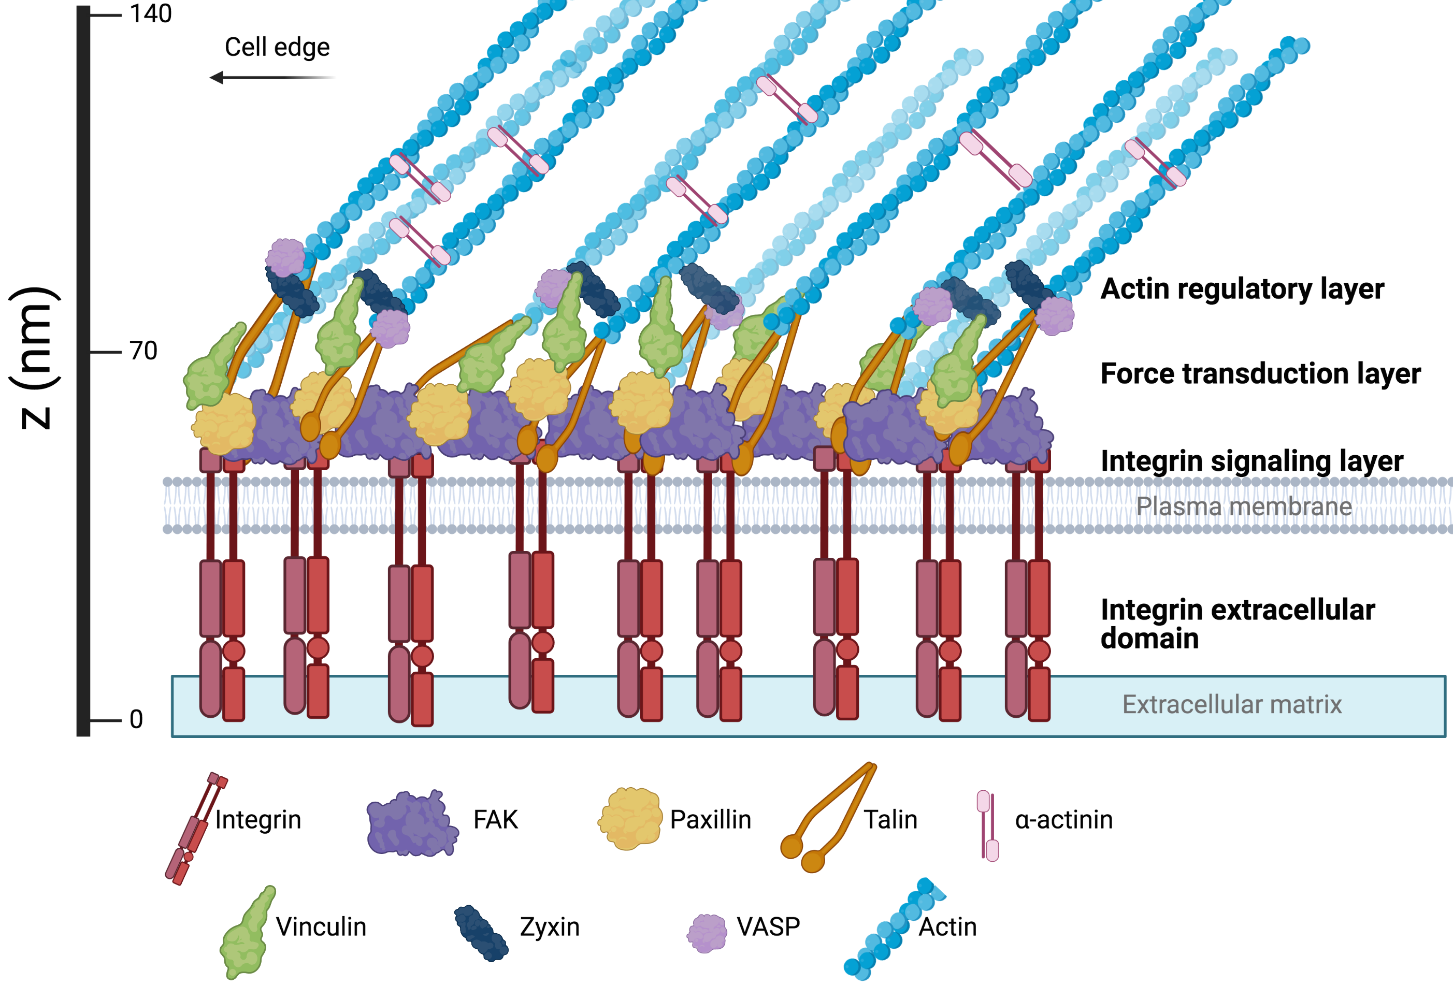
Notes:
Figure 8.3: ﻿Focal adhesions contain hundreds of proteins that function to link the extracellular matrix to the actin cytoskeletal machinery.
Created with BioRender.com.

Slide 5
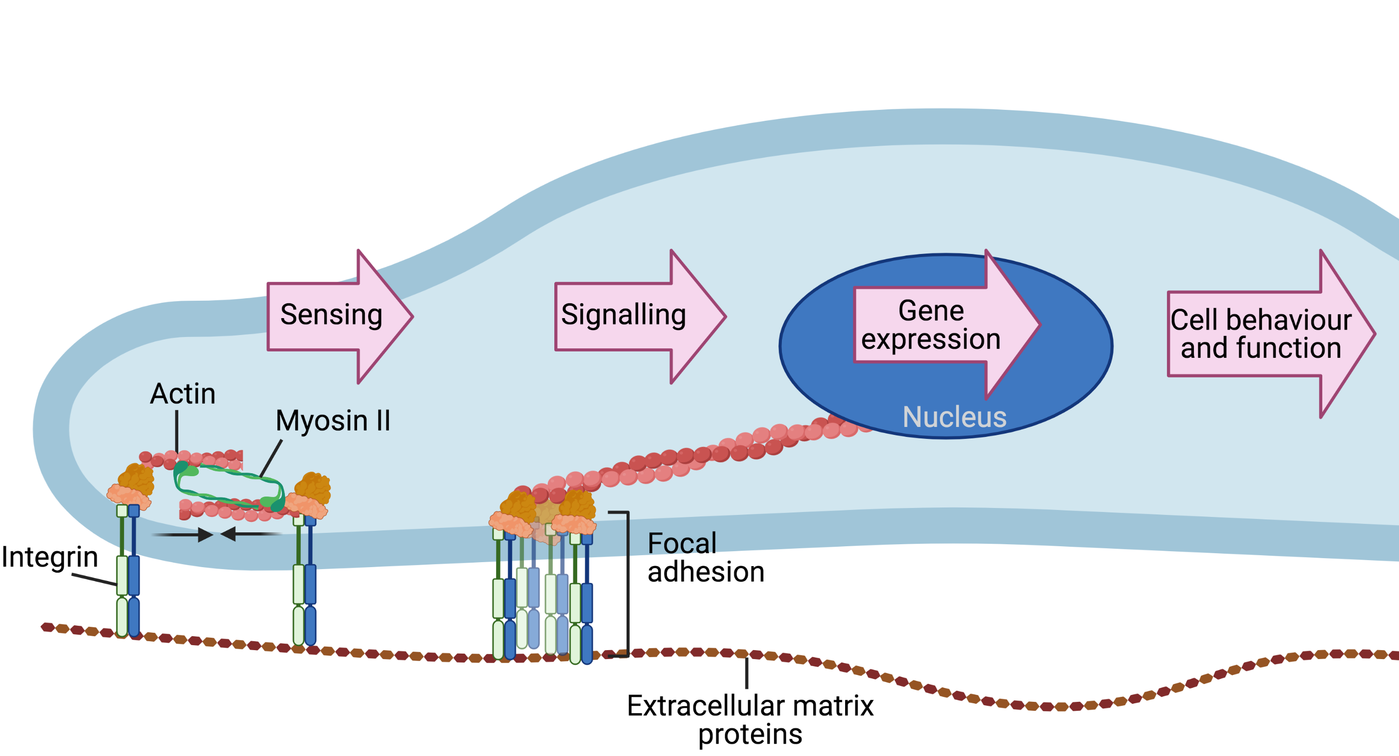
Notes:
Figure 8.4: Mechanotransduction leads to changes in gene expression and cell behavior.
Created with BioRender.com.

Slide 6
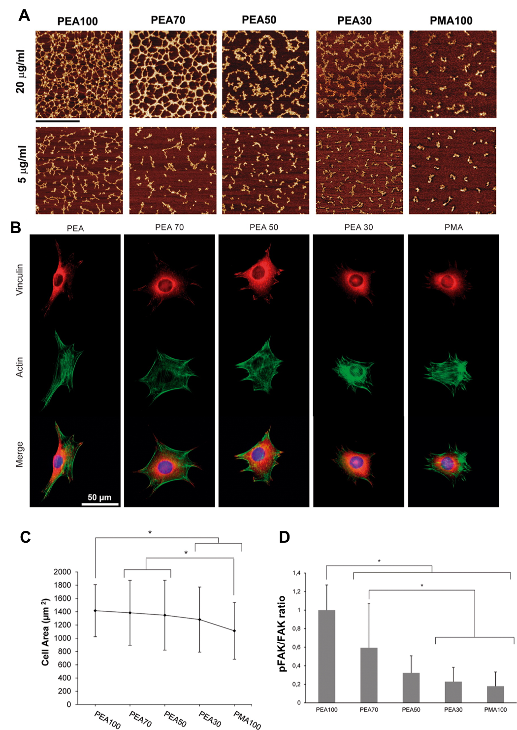
Notes:
Figure 8.5: Surface chemistry controls fibronectin (FN) network assembly and cell adhesion, morphology, and signaling.
From Controlled Assembly of Fibronectin Nanofibrils Triggered by Random Copolymer Chemistry, Mnatsakanyan, H. et al ACS Appl. Mater. Interfaces 7, 18125–18135 (2015).

Slide 7
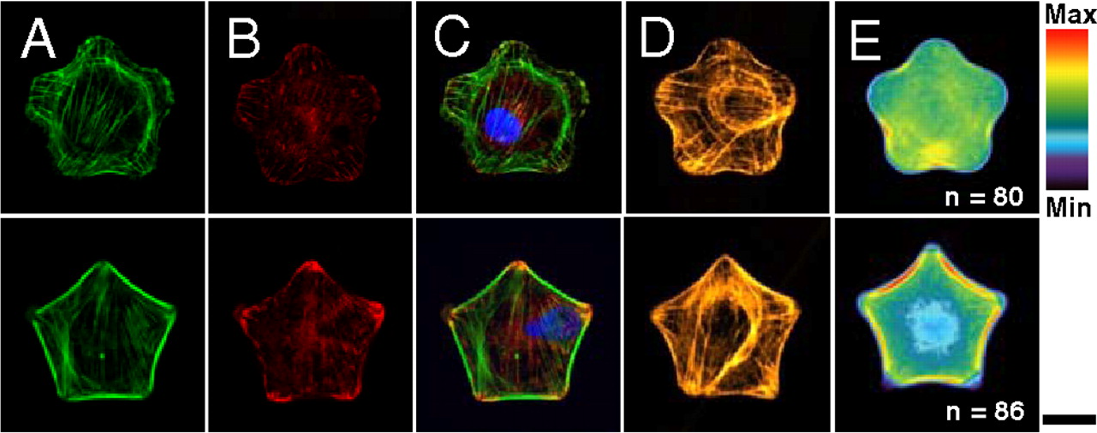
Notes:
Figure 8.6: Geometric cues direct differentiation of mesenchymal stem cells. A-D) Immunofluorescent images of F-actin (green), vinculin (red) and nuclei (blue), myosin IIa (yellow). E) Fluorescent heatmaps of myosin IIa contractility.
From Geometric cues for directing the differentiation of mesenchymal stem cells, Kilian, K. a, Bugarija, B., Lahn, B. T. & Mrksich, M. Proc. Natl. Acad. Sci. U. S. A. 107, 4872–7 (2010).

Slide 8
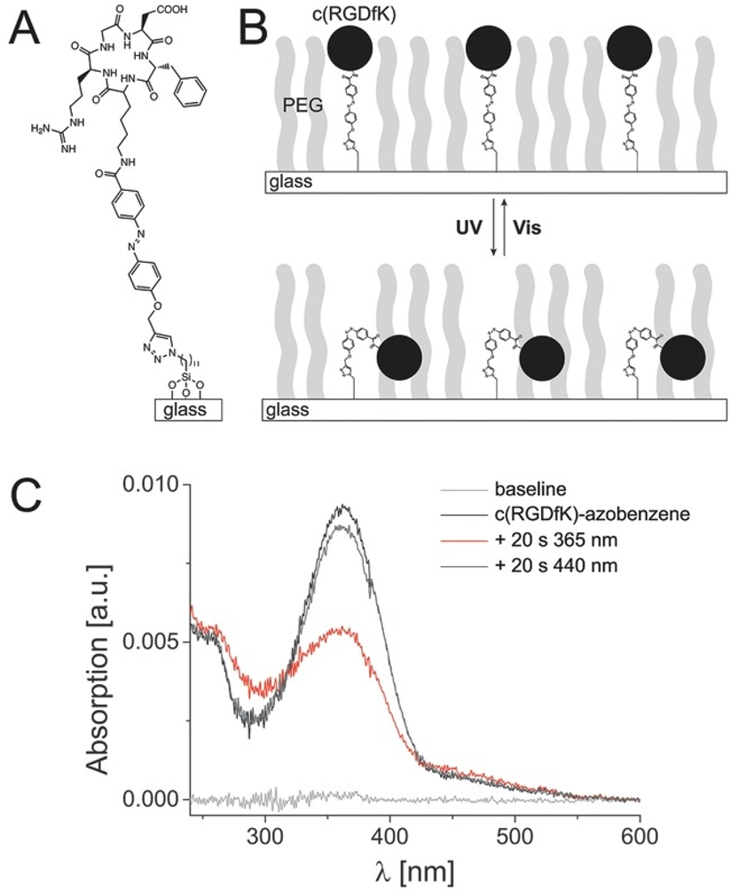
Notes:
Figure 8.7: Reversible stimulus-responsive materials containing c(RGDfK)-azobenzene. A-B) Structure of the c(RGDfK)-azobenzene, functionalized on PEG. C) UV–vis spectra.
From Rapid Reversible Photoswitching of Integrin-Mediated Adhesion at the Single-Cell Level, Kadem, L. F. et al. Adv. Mater. 28, 1799–1802 (2016).

Slide 9
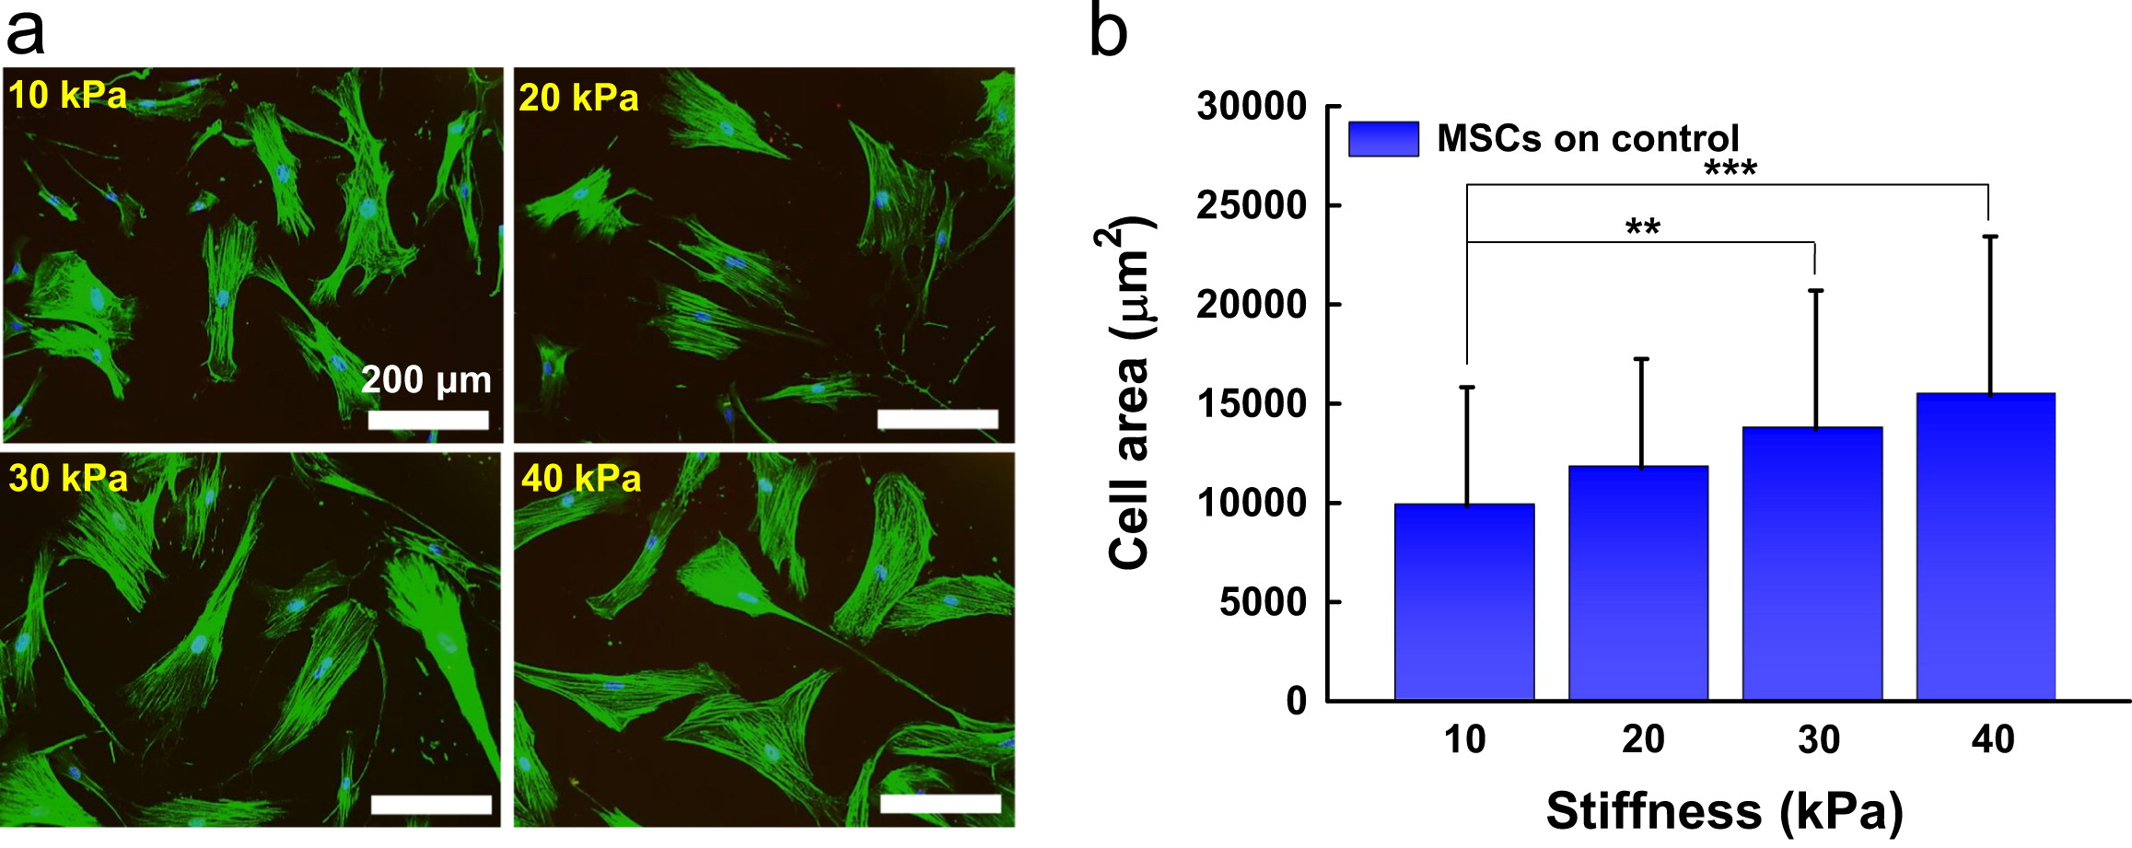
Notes:
Figure 8.8: Increasing substrate stiffness leads to increased cellular spreading in MSCs. a) Immunofluorescence images, green = actin. b) Quantification of cell area.
Controlling cell geometry on substrates of variable stiffness can tune the degree of osteogenesis in human mesenchymal stem cells, Lee et al. Mech. Behav. Biomed. Mater. 38, 209–218 (2014).

Slide 10
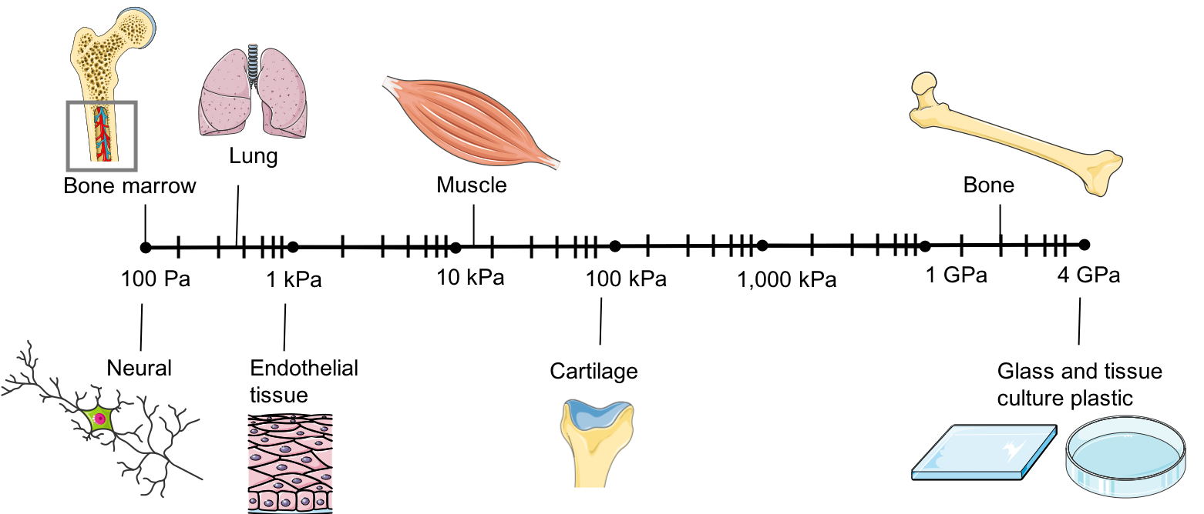
Notes:
Figure 8.9: ﻿ Biomechanical properties of various tissues in terms of stiffness (elastic modulus) in kilopascals (kPa).
Created with BioRender.com

Slide 11
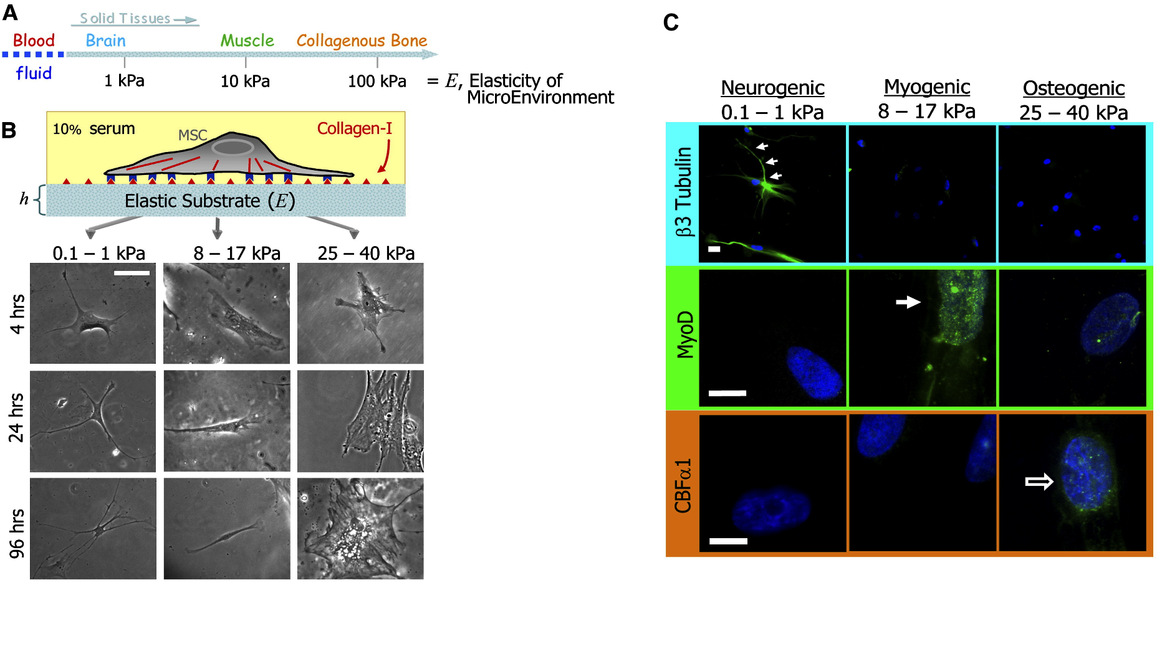
Notes:
Figure 8.10: Matrix stiffness directs lineage specification of MSCs. A) scale of stiffnesses (E) exhibited by solid tissues. B) Light microscope images. C) Immunofluorescence images of lineage specific markers.
From Matrix elasticity directs stem cell lineage specification, Engler, A. J. et al., 2006Cell, 126(4), pp. 677–89.

Slide 12
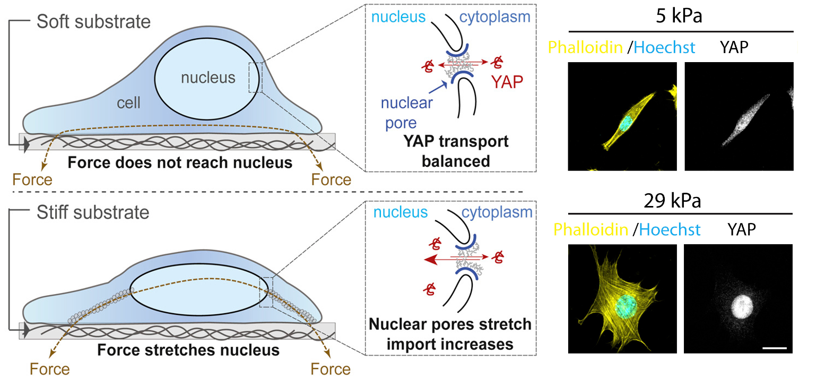
Notes:
Figure 8.11:﻿ Mechanical coupling of extra cellular matrix (ECM) to the nucleus, leads to translocation of YAP from the cytoplasm to the nucleus on stiff substrates.
From Force triggers YAP nuclear entry by mechanically regulating transport across nuclear pores, Elosegui-Artola, A. et al. Cell (in press), 2017).

Slide 13
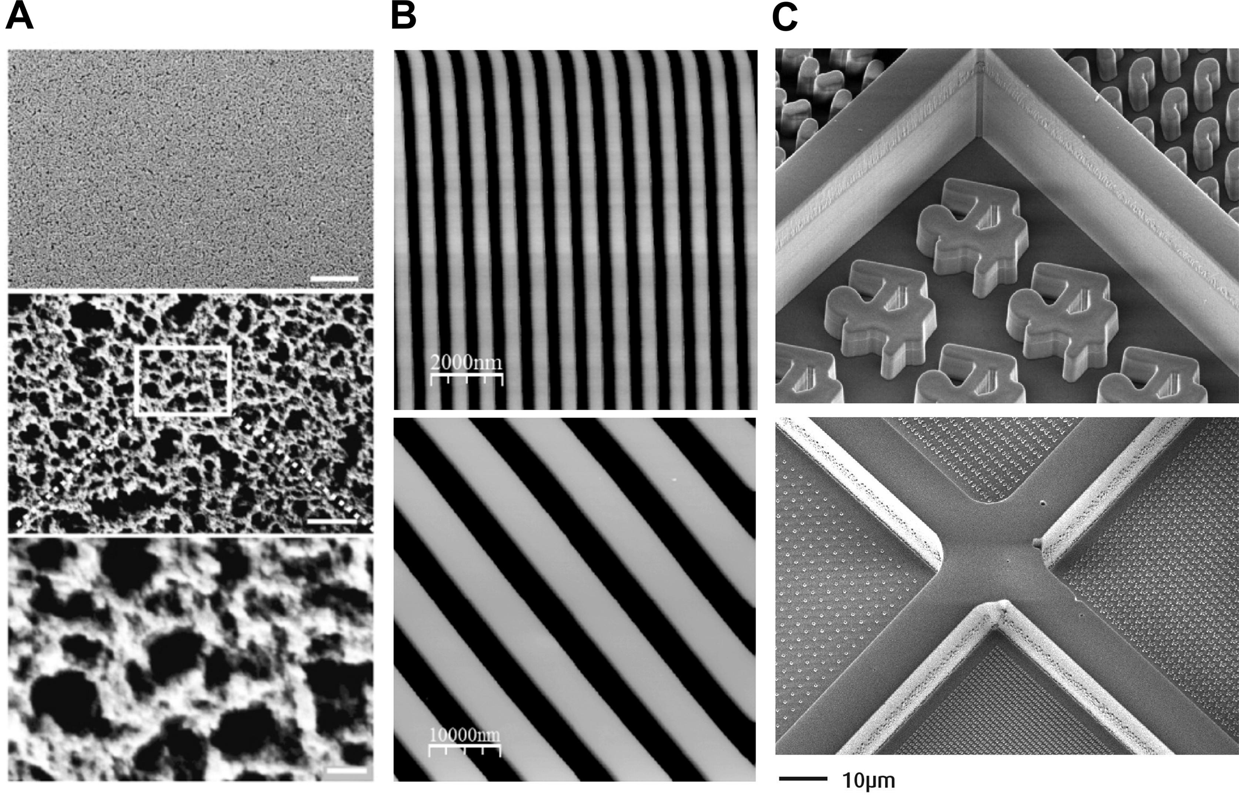
Notes:
Figure 8.12: Scanning electron microscopy image examples of surface topographies. A) Surface roughness. B) Grooves. C) High throughput topography platforms.
A from Jaggy, M. et al. Hierarchical Micro-Nano Surface Topography Promotes Long-Term Maintenance of Undifferentiated Mouse Embryonic Stem Cells. Nano Lett. 15, 7146–7154 (2015). B from Pan, F. et al. Topographic effect on human induced pluripotent stem cells differentiation towards neuronal lineage. Biomaterials 34, 8131–8139 (2013). C from Hulshof, F. F. B. et al. NanoTopoChip: High-throughput nanotopographical cell instruction. Acta Biomater. 62, 188–198 (2017).

Slide 14
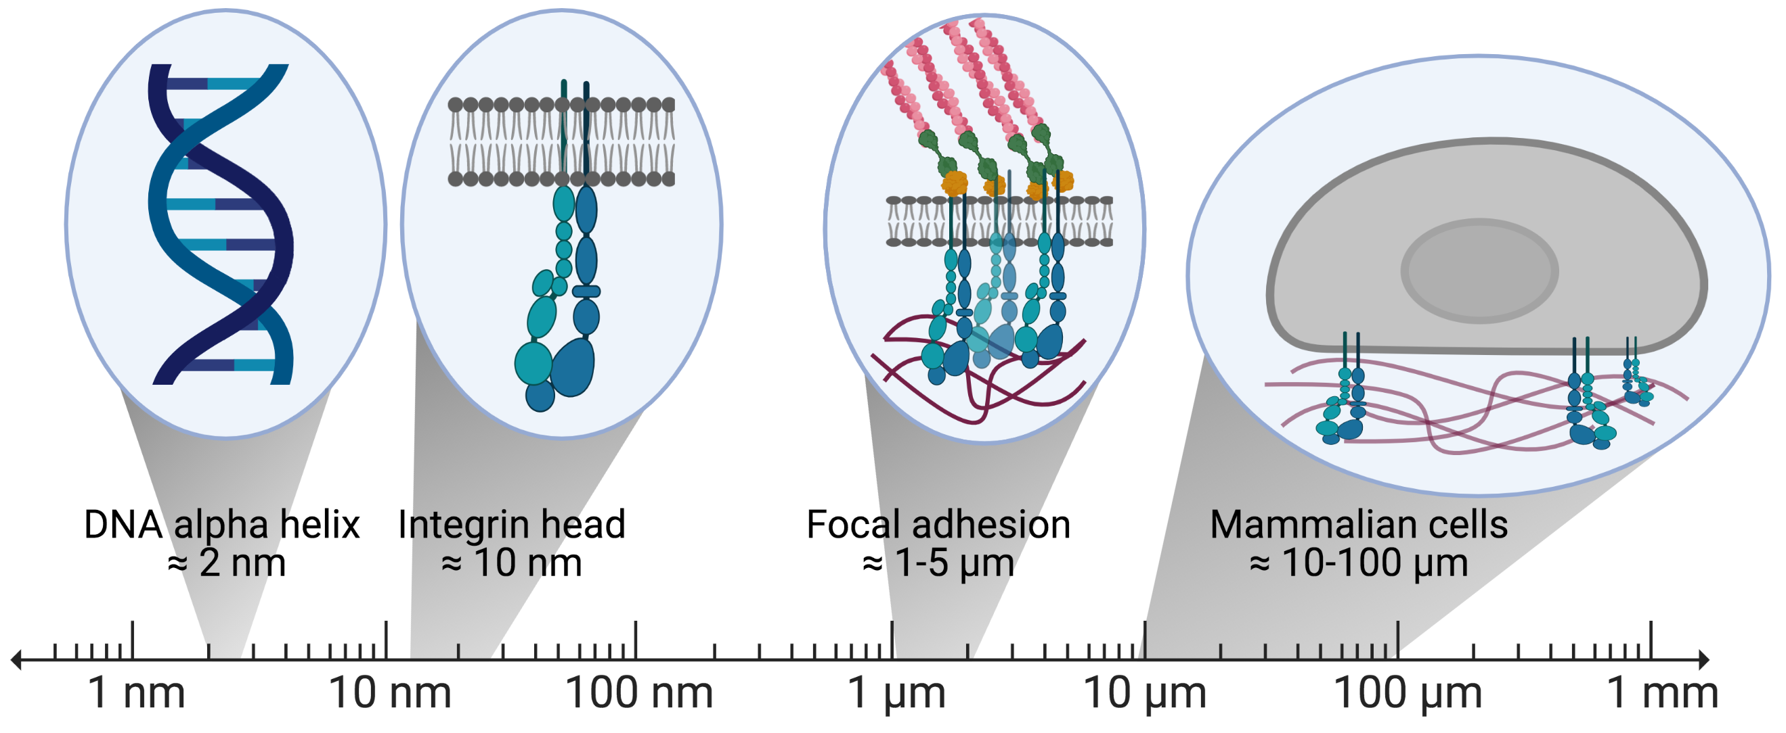
Notes:
Figure 8.13: Scale of cellular components.
Created with BioRender.com.

Slide 15
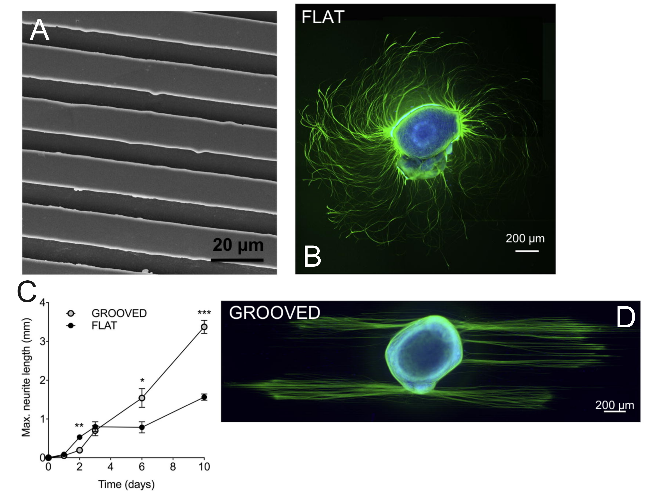
Notes:
Figure 8.14: Dorsal root ganglia cultured on microgrooved substrates. A) microgrooves. B) quantification of neurite length. C-D) green – b-tubulin.
From Microtopographical cues promote peripheral nerve regeneration via transient mTORC2 activation, Thomson et al., Acta Biomater. 60, 220–231 (2017).

Slide 16
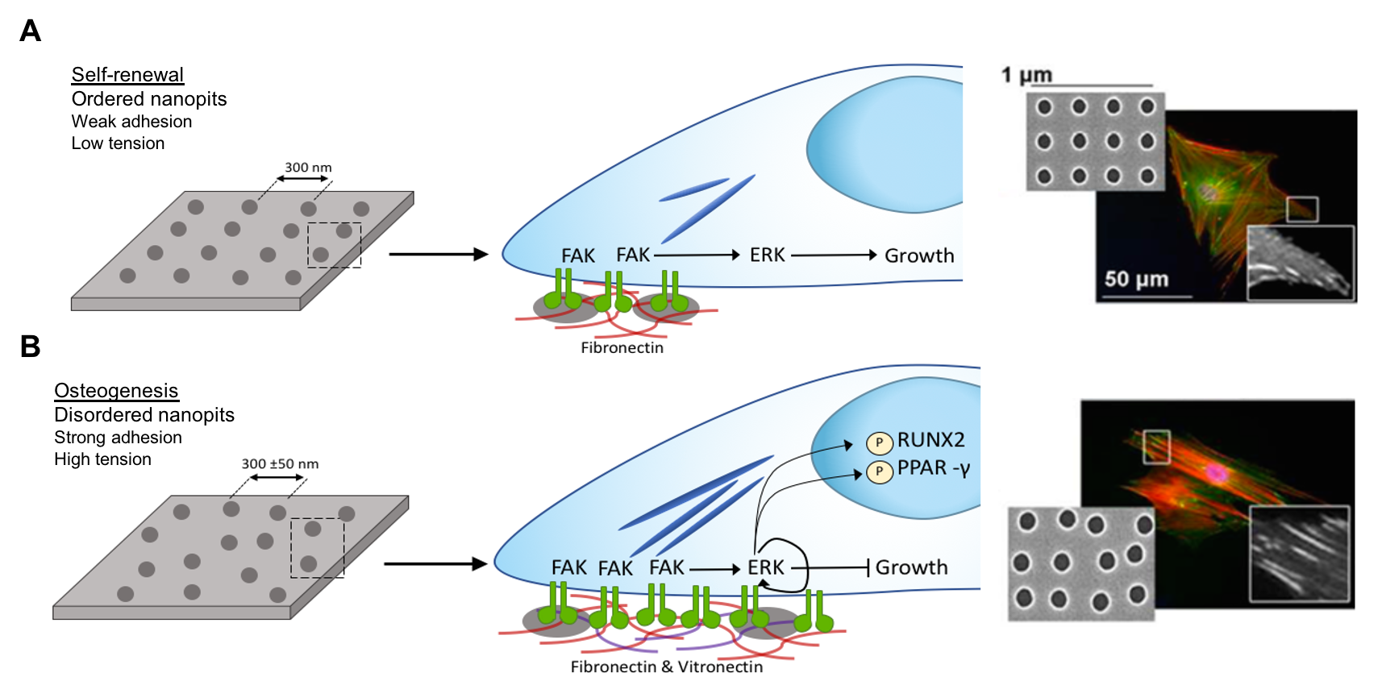
Notes:
Figure 8.15: Nanopit topographies control MSCs self-renewal and differentiation through control of adhesion formation.
From Designing stem cell niches for differentiation and self-renewal, Donnelly, Salmerón-Sánchez and Dalby, J. R. Soc. Interface, 2018.

Slide 17
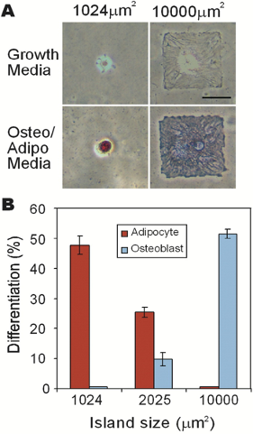
Notes:
Figure 8.16: Cell shape derived lineage commitment. A) Light microscopy images, lipid sain=red; alkaline phosphatase stain=blue. B) Percentage cell differentiation.
From Cell shape, cytoskeletal tension, and RhoA regulate stem cell lineage commitment, McBeath et al., Dev. Cell 6, 483–95 (2004).

Slide 18
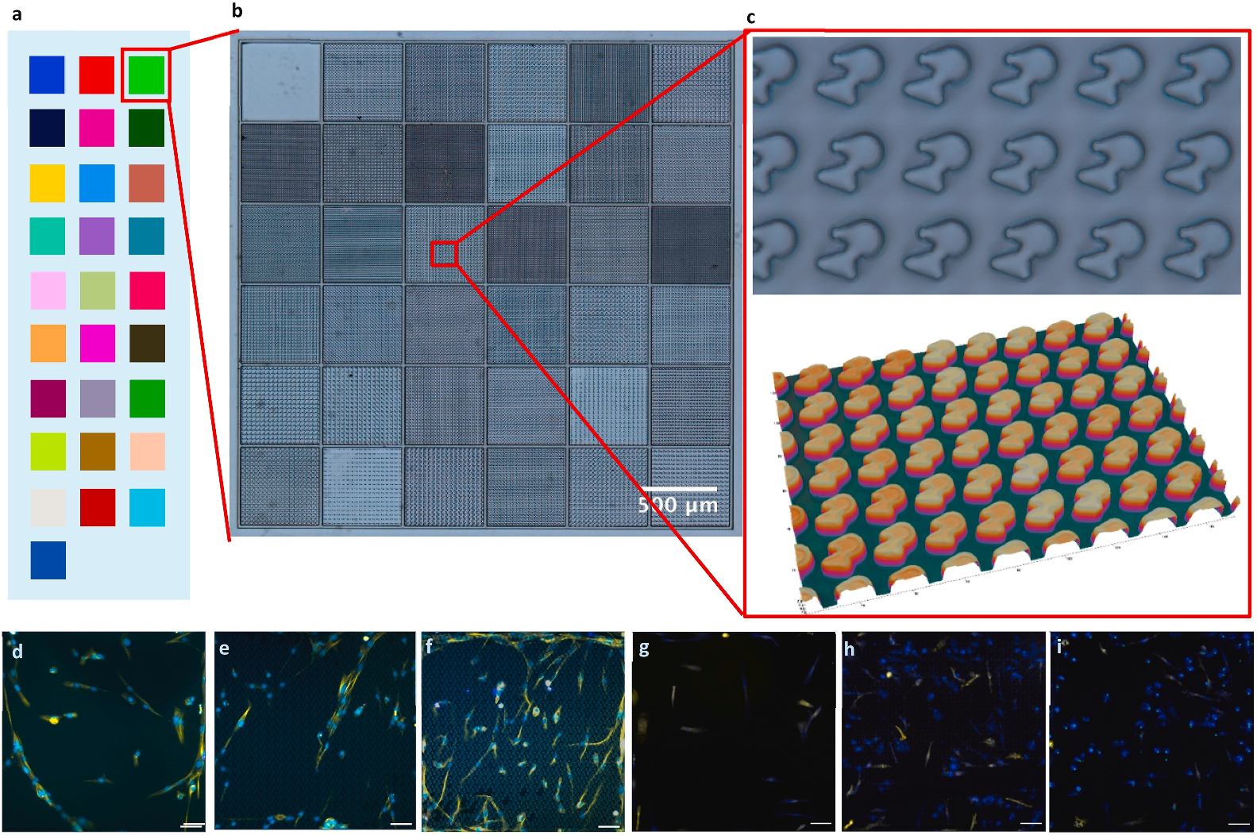
Notes:
Figure 8.17: a) Schematic showing ChemoTopoChip layout with colors representing different chemistries. b-c) Example features. d-i) Immunofluorescence of hiMSCs and macrophages.
From Discovery of synergistic material-topography combinations to achieve immunomodulatory osteoinductive biomaterials using a novel in vitro screening method: The ChemoTopoChip, Burroughs et al., Biomaterials 271, 120740 (2021).

